Slide 1
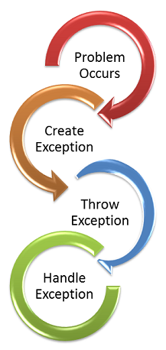
Java- Exception Handling

Slide 2
What is an Exception in Java?
What is an exception?
An Exception is an unwanted event that interrupts the normal flow of the program. When an exception occurs program execution gets terminated. In such cases we get a system generated error message. The good thing about exceptions is that they can be handled in Java. By handling the exceptions we can provide a meaningful message to the user about the issue rather than a system generated message, which may not be understandable to a user.
What is Exception handling?
Exception handling is one of the most important feature of java programming that allows us to handle the runtime errors caused by exceptions.
Why an exception occurs?
There can be several reasons that can cause a program to throw exception. For example: Opening a non-existing file in your program, Network connection problem, bad input data provided by user etc

Slide 3
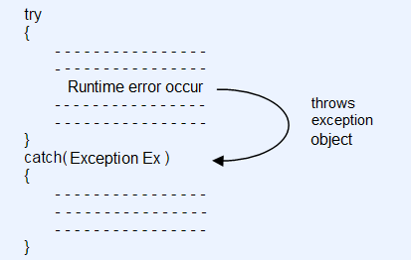

Slide 4
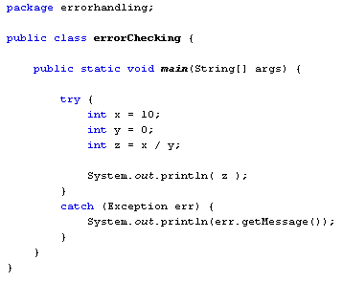

Slide 5
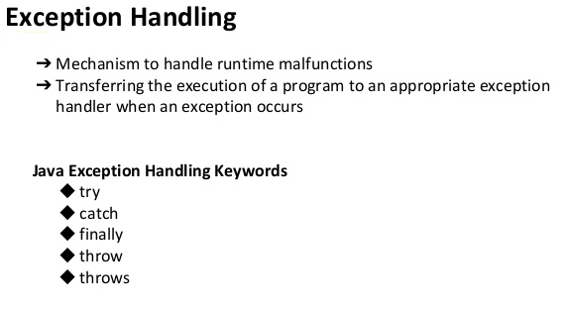

Slide 6
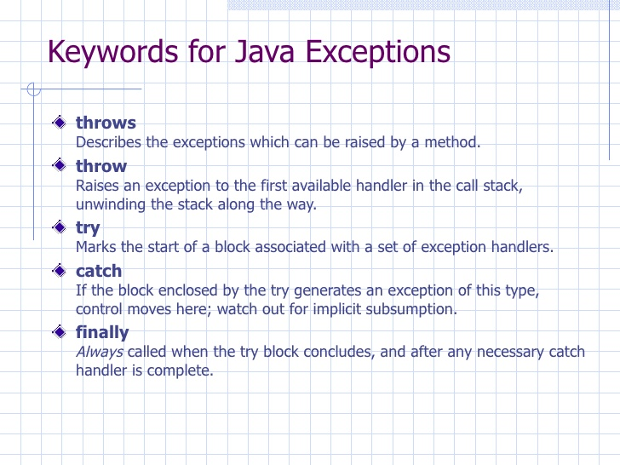

Slide 7
Exception Handling
If an exception occurs, which has not been handled by programmer then program execution gets terminated and a system generated error message is shown to the user. For example look at the system generated exception below:
An exception generated by the system is given below
Exception in thread "main"
java.lang.ArithmeticException: / by zero at ExceptionDemo.main(ExceptionDemo.java:5)
ExceptionDemo : The class name
main : The method name
ExceptionDemo.java : The filename
java:5 : Line number
This message is not user friendly so a user will not be able to understand what went wrong. In order to let them know the reason in simple language, we handle exceptions. We handle such conditions and then prints a user friendly warning message to user, which lets them correct the error as most of the time exception occurs due to bad data provided by user.

Slide 8
Advantage of Exception Handling
Exception handling ensures that the flow of the program doesn’t break when an exception occurs.
For example, if a program has bunch of statements and an exception occurs mid way after executing certain statements then the statements after the exception will not execute and the program will terminate abruptly.
By handling we make sure that all the statements execute and the flow of program doesn’t break.

Slide 9
Difference between Error and Exception
Errors indicate that something severe enough has gone wrong, the application should crash rather than try to handle the error.
Exceptions are events that occurs in the code. A programmer can handle such conditions and take necessary corrective actions. Few examples:
NullPointerException – When you try to use a reference that points to null.
ArithmeticException – When bad data is provided by user, for example, when you try to divide a number by zero this exception occurs because dividing a number by zero is undefined.
ArrayIndexOutOfBoundsException – When you try to access the elements of an array out of its bounds, for example array size is 5 (which means it has five elements) and you are trying to access the 10th element.

Slide 10
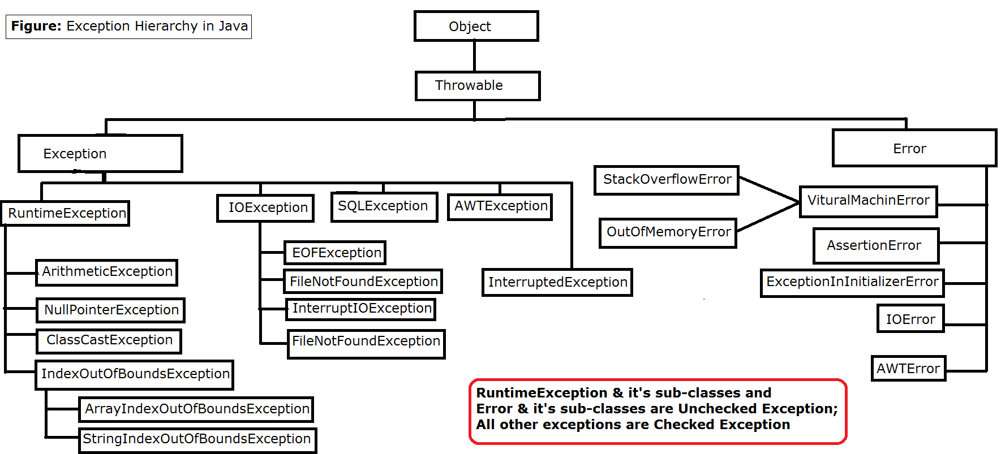

Slide 11
Types of Exceptions: There are two types of exceptions in Java:
Checked Exceptions
Unchecked Exceptions
Checked exceptions
All exceptions other than Runtime Exceptions are known as Checked exceptions as the compiler checks them during compilation to see whether the programmer has handled them or not. If these exceptions are not handled/declared in the program, you will get compilation error. For example, SQLException, IOException, ClassNotFoundException etc.
Unchecked Exceptions
Runtime Exceptions are also known as Unchecked Exceptions. These exceptions are not checked at compile-time so compiler does not check whether the programmer has handled them or not but it’s the responsibility of the programmer to handle these exceptions and provide a safe exit. For example, ArithmeticException, NullPointerException, ArrayIndexOutOfBoundsException etc.
Compiler will never force you to catch such exception or force you to declare it in the method using throws keyword.

Slide 12
Checked and Unchecked Exceptions
There are two types of exceptions:
Checked Exception and Unchecked Exception. The main difference between checked and unchecked exception is that the checked exceptions are checked at compile-time while unchecked exceptions are checked at runtime.
What are Checked Exceptions?
Checked Exceptions are checked at compile-time. It means if a method is throwing a checked exception then it should handle the exception using try-catch block or it should declare the exception using throws keyword, otherwise the program will give a compilation error.
Lets understand this with the help of an example:
CheckedException.java
C:\Java_Training_2018\Programs>javac CheckedException.java
CheckedException.java:10: error: unreported exception FileNotFoundException; must be caught or declared to be thrown
fis = new FileInputStream("input.txt");
^
CheckedException.java:16: error: unreported exception IOException; must be caught or declared to be thrown
while(( k = fis.read() ) != -1)
^
CheckedException.java:23: error: unreported exception IOException; must be caught or declared to be thrown
fis.close();
^
3 errors

Slide 13
Why this compilation error?
As I mentioned in the beginning that checked exceptions gets checked during compile time. Since we didn’t handled/declared the exceptions, our program gave the compilation error.
How to resolve the error?
There are two ways to avoid this error. We will see both the ways one by one.
Method 1: Declare the exception using throws keyword.
As we know that all three occurrences of checked exceptions are inside main() method so one way to avoid the compilation error is: Declare the exception in the method using throws keyword. You may be thinking that our code is throwing FileNotFoundException and IOException both then why we are declaring the IOException alone. The reason is that IOException is a parent class of FileNotFoundException so it by default covers that. If you want you can declare them like this public static void main(String args[]) throws IOException, FileNotFoundException.
CheckedException1.java
Output:
File content is displayed on the screen.

Slide 14
Method 2: Handle them using try-catch blocks.
The approach we have used above is not good at all. It is not the best exception handling practice. You should give meaningful message for each exception type so that it would be easy for someone to understand the error. The code should be like this:
CheckedException2.java
C:\Java_Training_2018\Programs>java -cp . CheckedException2
The specified file is not present at the given path
Exception in thread "main" java.lang.NullPointerException
at CheckedException2.main(CheckedException2.java:14)
C:\Java_Training_2018\Programs>
This code will run fine and will display the file content if file is present.
Here are the few other Checked Exceptions –
SQLException
IOException
ClassNotFoundException
InvocationTargetException

Slide 15
What are Unchecked Exceptions?
Unchecked Exceptions are not checked at compile time. It means if your program is throwing an unchecked exception and even if you didn’t handle/declare that exception, the program won’t give a compilation error. Most of the times these exception occurs due to the bad data provided by user during the user-program interaction. It is up to the programmer to judge the conditions in advance, that can cause such exceptions and handle them appropriately.
All Unchecked exceptions are direct sub classes of
RuntimeException class.
Lets understand this with an example:
UnCheckedException.java
If you compile this code, it would compile successfully however when you will run it, it would throw ArithmeticException. That clearly shows that unchecked exceptions are not checked at compile-time, they occurs at runtime.
UncheckedException.java
This code would also compile successfully since ArrayIndexOutOfBoundsException is also an unchecked exception.

Slide 16
Note:
It doesn’t mean that compiler is not checking these exceptions so we shouldn’t handle them. In fact we should handle them more carefully. For e.g. In the above example there should be a exception message to user that they are trying to display a value which doesn’t exist in array so that user would be able to correct the issue.
Output:
The specified index does not exist in array. Please correct the error.
Here are the few unchecked exception classes:
NullPointerException
ArrayIndexOutOfBoundsException
ArithmeticException
IllegalArgumentException
NumberFormatException

Slide 17
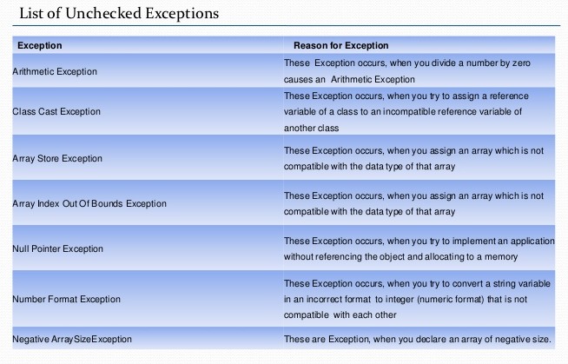

Slide 18
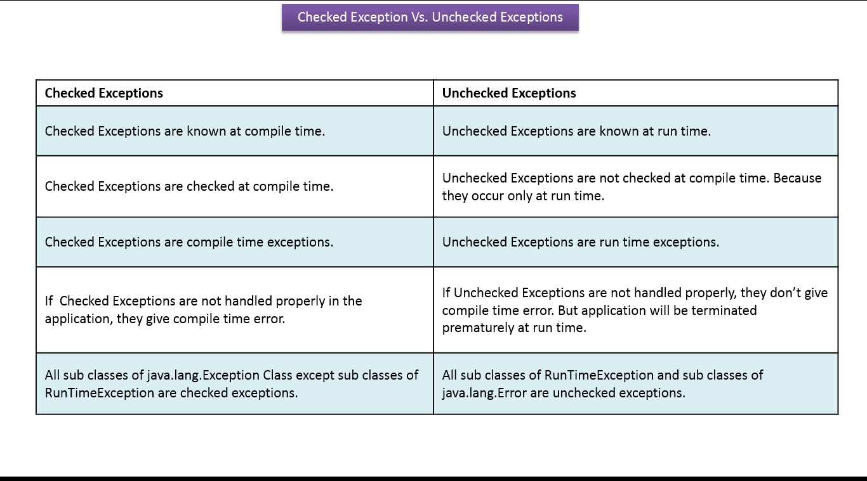

Slide 19
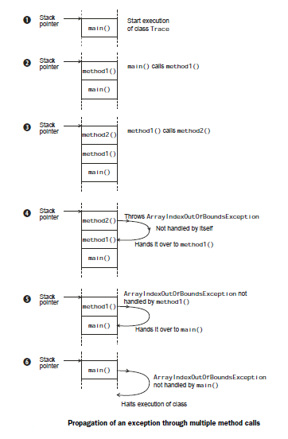
What happens when an error occurs?

Slide 20
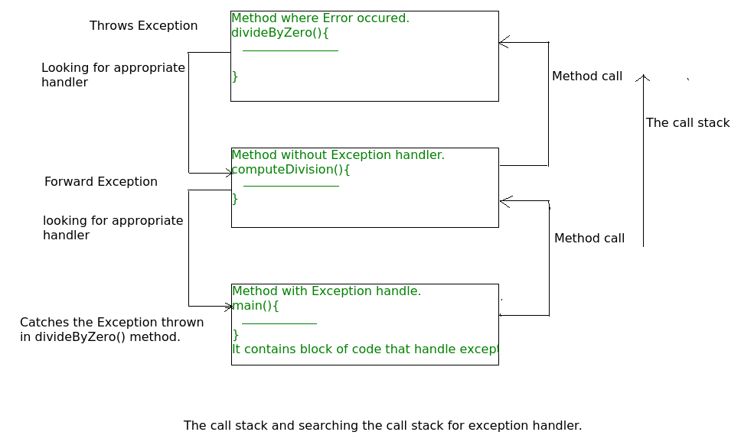

Slide 21
Flow of control in try/catch blocks
When exception doesn’t occur:
When the statements that are present in try block doesn’t throw any exception then first, the body of try block executes and then the code after catch blocks. In this case catch block never runs as they are meant to run when an exception occurs.
TryCatchFlow.java
In the above example exception didn’t occur in try block so catch block didn’t run.
When exception occurs:
First have a look at the example below and then we will discuss the output:
TryCatchFlow1.java

Slide 22
Point to note in above example: There are two statements present inside try block. Since exception occurred because of first statement, the second statement didn’t execute. Hence we can conclude that if an exception occurs then the rest of the try block doesn’t execute and control passes to catch block.
Flow of control in try/catch/finally blocks:
If exception occurs in try block’s body then control immediately transferred(skipping rest of the statements in try block) to the catch block. Once catch block finished execution then finally block and after that rest of the program.
If there is no exception occurred in the code which is present in try block then first, the try block gets executed completely and then control gets transferred to finally block (skipping catch blocks).
If a return statement is encountered either in try or catch block. In this case finally block runs. Control first jumps to finally and then it returned back to return statement.
TryCatchFlow2.java

Slide 23
How to throw exception
In Java we have already defined exception classes such as ArithmeticException, NullPointerException, ArrayIndexOutOfBounds exception etc. These exceptions are set to trigger on different-2 conditions. For example when we divide a number by zero, this triggers ArithmeticException, when we try to access the array element out of its bounds then we get ArrayIndexOutOfBoundsException.
We can define our own set of conditions or rules and throw an exception explicitly using throw keyword. For example, we can throw ArithmeticException when we divide number by 5, or any other numbers, what we need to do is just set the condition and throw any exception using throw keyword. Throw keyword can also be used for throwing custom exceptions, I have covered that in a separate tutorial, see Custom Exceptions in Java.
Syntax of throw keyword:
throw new exception_class("error message");
For example:
throw new ArithmeticException("dividing a number by 5 is not allowed in this program");

Slide 24
Example of throw keyword
ThrowExample.java
Lets say we have a requirement where we need to only register the students when their age is less than 12 and weight is less than 40, if any of the condition is not met then the user should get an ArithmeticException with the warning message “Student is not eligible for registration”.
We have implemented the logic by placing the code in the method that checks student eligibility if the entered student age and weight doesn’t met the criteria then we throw the exception using throw keyword.
In the above example we have throw an unchecked exception, same way we can throw uncheckedand user-defined exception as well.

Slide 25
Difference between throw and throws
Throw vs Throws in java
1. Throws clause is used to declare an exception, which means it works similar to the try-catch block. On the other hand throw keyword is used to throw an exception explicitly.
2. If we see syntax wise than throw is followed by an instance of Exception class and throws is followed by exception class names.
For example:
throw new ArithmeticException("Arithmetic Exception");
throws ArithmeticException;
3. Throw keyword is used in the method body to throw an exception, while throws is used in method signature to declare the exceptions that can occur in the statements present in the method.

Slide 26
For example:
Throw:
...
void myMethod() {
try {
//throwing arithmetic exception using throw
throw new ArithmeticException("Something went wrong!!");
}
catch (Exception exp) {
System.out.println("Error: "+exp.getMessage());
}
}
...
Throws:
...
//Declaring arithmetic exception using throws
void sample() throws ArithmeticException{
//Statements
}
...

Slide 27
4. You can throw one exception at a time but you can handle multiple exceptions by declaring them using throws keyword.
For example:
Throw:
void myMethod() {
//Throwing single exception using throw
throw new ArithmeticException("An integer should not be divided by zero!!");
}
..
Throws:
//Declaring multiple exceptions using throws
void myMethod() throws ArithmeticException, NullPointerException{
//Statements where exception might occur
}
These were the main differences between throw and throws in Java. Lets see complete examples of throw and throws keywords.
Throw Example : Throw.java
Throws Example : Throws.java

Slide 28
Try Catch in Java – Exception handling
Try block
The try block contains set of statements where an exception can occur. A try block is always followed by a catch block, which handles the exception that occurs in associated try block. A try block must be followed by catch blocks or finally block or both.
Syntax of try block
try{
//statements that may cause an exception
}
While writing a program, if you think that certain statements in a program can throw a exception, enclosed them in try block and handle that exception

Slide 29
Try Catch in Java – Exception handling
Catch block
A catch block is where you handle the exceptions, this block must follow the try block. A single try block can have several catch blocks associated with it. You can catch different exceptions in different catch blocks. When an exception occurs in try block, the corresponding catch block that handles that particular exception executes.
For example if an arithmetic exception occurs in try block then the statements enclosed in catch block for arithmetic exception executes.
Syntax of try catch in java
try
{
//statements that may cause an exception
}
catch (exception(type) e(object))‏
{
//error handling code
}

Slide 30
Example: try catch block
If an exception occurs in try block then the control of execution is passed to the corresponding catch block. A single try block can have multiple catch blocks associated with it, you should place the catch blocks in such a way that the generic exception handler catch block is at the last(see in the example below).
The generic exception handler can handle all the exceptions but you should place is at the end, if you place it at the before all the catch blocks then it will display the generic message. You always want to give the user a meaningful message for each type of exception rather then a generic message.
TryCatch.java
Output:
You should not divide a number by zero
I'm out of try-catch block in Java.
Multiple catch blocks
The example above multiple catch blocks.
1. A single try block can have any number of catch blocks.
2. A generic catch block can handle all the exceptions. Whether it is ArrayIndexOutOfBoundsException or ArithmeticException or NullPointerException or any other type of exception, this handles all of them.

Slide 31
catch(Exception e){
//This catch block catches all the exceptions
}
We need other catch handlers when we have a generic that can handle all. This is because in generic exception handler you can display a message but you are not sure for which type of exception it may trigger so it will display the same message for all the exceptions and user may not be able to understand which exception occurred. That's the reason you should place is at the end of all the specific exception catch blocks
3. If no exception occurs in try block then the catch blocks are completely ignored.
4. Corresponding catch blocks execute for that specific type of exception:
catch(ArithmeticException e) is a catch block that can handle ArithmeticException
catch(NullPointerException e) is a catch block that can handle NullPointerException
5. You can also throw exception.
TryCatch1.java
In the above example there are multiple catch blocks and these catch blocks executes sequentially when an exception occurs in try block. Which means if you put the last catch block ( catch(Exception e)) at the first place, just after try block then in case of any exception this block will execute as it can handle all exceptions. This catch block should be placed at the last to avoid such situations.

Slide 32
finally block
A finally block contains all the crucial statements that must be executed whether exception occurs or not. The statements present in this block will always execute regardless of whether exception occurs in try block or not such as closing a connection, stream etc.
Syntax of Finally block
try {
//Statements that may cause an exception
}
catch {
//Handling exception
}
finally {
//Statements to be executed
}
A Simple Example of finally block
Finally.java
Here you can see that the exception occurred in try block which has been handled in catch block, after that finally block got executed.
Output:
Number should not be divided by zero
This is finally block
Out of try-catch-finally

Slide 33
Important points regarding finally block
1. A finally block must be associated with a try block, you cannot use finally without a try block. You should place those statements in this block that must be executed always.
2. Finally block is optional, as we have seen in previous tutorials that a try-catch block is sufficient for exception handling, however if you place a finally block then it will always run after the execution of try block.
3. In normal case when there is no exception in try block then the finally block is executed after try block. However if an exception occurs then the catch block is executed before finally block.
4. An exception in the finally block, behaves exactly like any other exception.
5. The statements present in the finally block execute even if the try block contains control transfer statements like return, break or continue.
Lets see an example to see how finally works when return statement is present in try block:
Another example of finally block and return statement Finally1.java
You can see that even though we have return statement in the method, the finally block still runs

Slide 34
Cases when the finally block doesn’t execute
The circumstances that prevent execution of the code in a finally block are:
The death of a Thread
Using of the System. exit() method.
Due to an exception arising in the finally block.
Finally and Close()
close() statement is used to close all the open streams in a program. Its a good practice to use close() inside finally block. Since finally block executes even if exception occurs so you can be sure that all input and output streams are closed properly regardless of whether the exception occurs or not.
For example:
....
try{
OutputStream osf = new FileOutputStream( "filename" );
OutputStream osb = new BufferedOutputStream(opf);
ObjectOutput op = new ObjectOutputStream(osb);
try{
output.writeObject(writableObject);
}
finally{
op.close();
}
}
catch(IOException e1){
System.out.println(e1);
}
...

Slide 35
Finally block without catch
A try-finally block is possible without catch block. Which means a try block can be used with finally without having a catch block.
...
InputStream input = null;
try {
input = new FileInputStream("inputfile.txt");
}
finally {
if (input != null) {
try {
in.close();
}catch (IOException exp) {
System.out.println(exp);
}
}
}
...

Slide 36
Finally block and System.exit()
System.exit() statement behaves differently than return statement. Unlike return statement whenever System.exit() gets called in try block then Finally block doesn’t execute. Here is a code snippet that demonstrate the same:
....
try {
//try block
System.out.println("Inside try block");
System.exit(0)
}
catch (Exception exp) {
System.out.println(exp);
}
finally {
System.out.println("Java finally block");
}
....
In the above example if the System.exit(0) gets called without any exception then finally won’t execute. However if any exception occurs while calling System.exit(0) then finally block will be executed.

Slide 37
try-catch-finally block
Either a try statement should be associated with a catch block or with finally.
Since catch performs exception handling and finally performs the cleanup, the best approach is to use both of them.
Syntax:
try {
//statements that may cause an exception
}
catch (…)‏ {
//error handling code
}
finally {
//statements to be executed
}
TryCatchFinally.java: The following example demonstrate the working of finally block when no exception occurs in try block.
TryCatchFinally1.java: : This example shows the working of finally block when an exception occurs in try block but is not handled in the catch block: As you can see that the system generated exception message is shown but before that the finally block successfully executed.
TryCatchFinally2.java: When exception occurs in try block and handled properly in catch block

Slide 38
Java Exception Handling examples
Arithmetic exception
Class: Java.lang.ArithmeticException
This is a built-in-class present in java.lang package. This exception occurs when an integer is divided by zero.
class ArithmeticEx {
public static void main(String args[]) {
try {
int num1=30, num2=0;
int output=num1/num2;
System.out.println ("Result: "+output);
}
catch(ArithmeticException e) {
System.out.println ("You Shouldn't divide a number by zero");
}
}
}
Output of above program:
You Shouldn't divide a number by zero

Slide 39
ArrayIndexOutOfBounds Exception
Class: Java.lang.ArrayIndexOutOfBoundsException
This exception occurs when you try to access the array index which does not exist. For example, If array is having only 5 elements and we are trying to display 7th element then it would throw this exception.
class ArrayIndexOutOfBounds {
public static void main(String args[]) {
try {
int a[]=new int[10];
//Array has only 10 elements
a[11] = 9;
}
catch(ArrayIndexOutOfBoundsException e){
System.out.println ("ArrayIndexOutOfBounds");
}
}
}

Slide 40
NumberFormat Exception
Class: Java.lang.NumberFormatException
This exception occurs when a string is parsed to any numeric variable.
For example, the statement int num=Integer.parseInt ("XYZ"); would throw NumberFormatException because String “XYZ” cannot be parsed to int.
class NumberFormat {
public static void main(String args[]) {
try{
int num=Integer.parseInt ("XYZ") ;
System.out.println(num);
}catch(NumberFormatException e){
System.out.println("Number format exception occurred");
}
}
}

Slide 41
StringIndexOutOfBound Exception
Class: Java.lang.StringIndexOutOfBoundsException
An object of this class gets created whenever an index is invoked of a string, which is not in the range.
Each character of a string object is stored in a particular index starting from 0.
To get a character present in a particular index of a string we can use a method charAt(int) of java.lang.String where int argument is the index.
class StringIndexOutOfBound {
public static void main(String args[])
{
try{
String str="beginnersbook";
System.out.println(str.length());;
char c = str.charAt(0);
c = str.charAt(40);
System.out.println(c);
}catch(StringIndexOutOfBoundsException e){
System.out.println("StringIndexOutOfBoundsException!!");
}
}
}

Slide 42
NullPointer Exception
Class: Java.lang.NullPointer Exception
An object of this class gets created whenever a member is invoked with a “null” object.
class NullPointer {
public static void main(String args[]) {
try{
String str=null;
System.out.println (str.length());
}
catch(NullPointerException e){
System.out.println("NullPointerException..");
}
}
}

Slide 43
User defined exception in java
In java we have already defined, exception classes such as ArithmeticException, NullPointerException etc. These exceptions are already set to trigger on pre-defined conditions such as when you divide a number by zero it triggers ArithmeticException, In the last tutorial we learnt how to throw these exceptions explicitly based on your conditions using throw keyword.
In java we can create our own exception class and throw that exception using throw keyword. These exceptions are known as user-defined or custom exceptions. In this tutorial we will see how to create your own custom exception and throw it on a particular condition.
UserDefinedexception.java
Explanation:
You can see that while throwing custom exception I gave a string in parenthesis ( throw new MyException("This is My error Message");). That’s why we have a parameterized constructor (with a String parameter) in my custom exception class.
Notes:
1. User-defined exception must extend Exception class.
2. The exception is thrown using throw keyword.

Slide 44
Another Example of Custom Exception
UserDefinedexception1.java
In this example we are throwing an exception from a method. In this case we should use throws clause in the method signature otherwise you will get compilation error saying that “unhandled exception in method”.

Slide 45
Real-Life Exception Handling Example
Imagine you are going river rafting on your vacation.
Your instructor informs you that while rafting you might fall off raft into the river while crossing the river.
In such situation you use your oar or rope thrown towards you to get back into the raft.
You might also throw into the river while rowing your raft.
In such situation you should not panic and should stay seated.
Towards the end what ever happens during training, you are paying for the this adventure sporting.
CustomException.java

